Slide 1
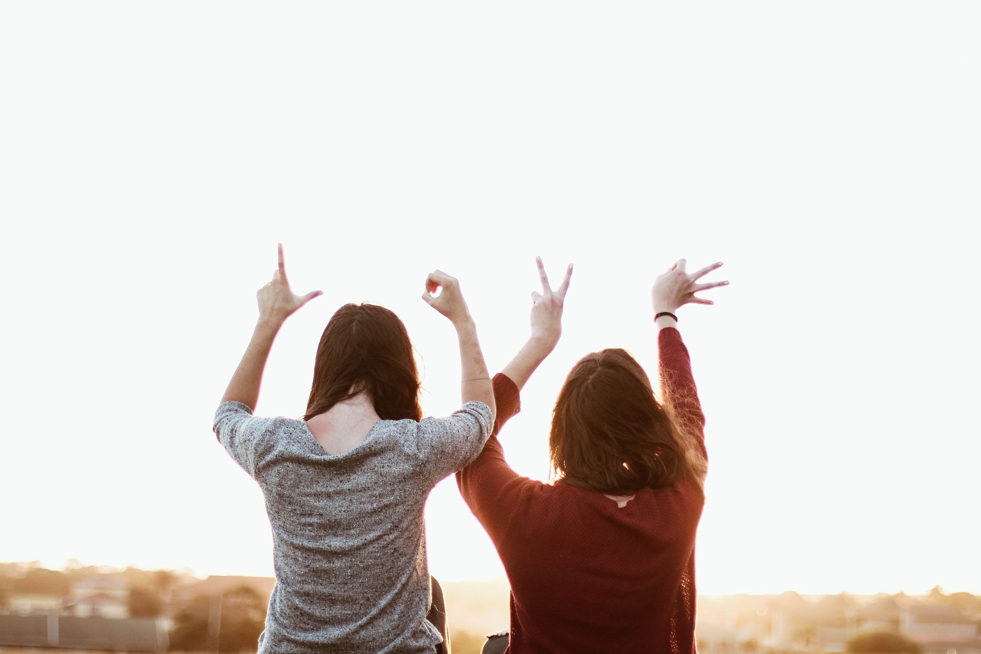
sign language conversation
DR.Hamada Nayel

Slide 2
CONTENTS
5
Introduction
Application features
1
6
Overview
Model Results
2
7
Why this project?
Sign language Animation
3
Objective
Conclusion
8
Technologies
Improvement and future work
4
Tools

Slide 3
Introduction

Slide 4
project overview
Sign language conversation (SLC) project is to help deaf people to communicate with anyone.
It will be easy to communicate by translating sign language and vise versa.
We aim in this project to translate sign language into voice record and translate voice into a stream of alphabet Arabic sign language.
So, The project is desktop application that based on python "Tkinter" that can translate sign language to voice and vise versa by using the power of computer vision and machine learning to recognize hand gestures and translate it and we use blender to make hand animations. finally, we make a full pair-to-pair communication.

Slide 5
why this project?
deaf people face a lot of challenges such as they can’t communicate in any place that provide survice such as restaurant or bank.
We found that is very hard to communicate with deaf people and we should learn sign language to communicate with them.
And it is not easy to learn sign language and this will take a lot of time.
Deaf people is around us they are a lot and they suffer.
So, we try to help them to live a better life and to interact with all surrounding.

Slide 6
How many they are?
Nearly
1.5
5
700
billion
Million
million
PEOPLE REQUIRE REHABILITATION TO ADDRESS THEIR HEARING LOSS.
OF EGYPT’S 100 MILLION RESIDENTS ARE DEAF.
PEOPLE IS ESTIMATED TO HAVE HEARING LOSS BY 2050

Slide 7
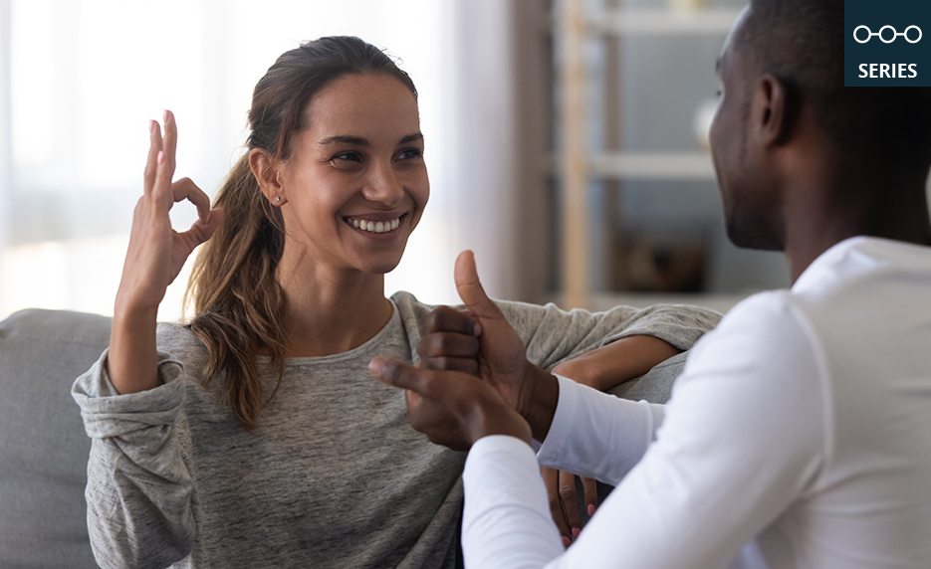

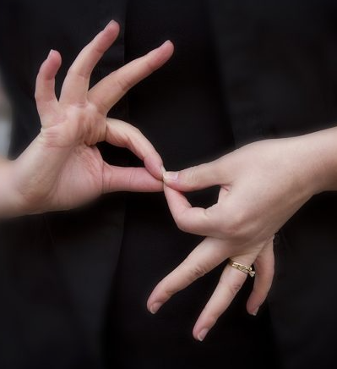
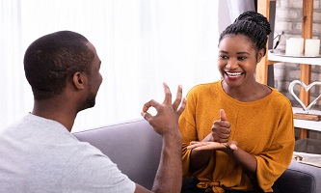
project objective
Translate sign language
The main purpose of the project to translate sign language to voice record.
Animate sign language
make animations for Arabic alphabet sign language to make a stream of animations to create a sentence so, we can convert voice to sign language.
Easy communication
one of the application goals to be easy use and make it easy to communicate with deaf people.

Slide 8
Technologies

Slide 9
Tools
Tkinter
Machine learning
Blender
Tkinter is our python-based library that we use to make application interface.
We used machine learning to detect hand gestures for Arabic alphabet sign language.
We used blender to make hand gestures animations for Arabic alphabet sign language.

Slide 10

Application
basis of the application
the application is based on TKINTER library that is based on python.
Application structure
the application contains two screens one for the deaf user and the other one is the normal user

Slide 11
CONT.
Deaf user screen
this screen has two containers one for camera that contains the model to predict Arabic alphabet sign language the other for the animation of sign language.
And has three buttons to start the camera, send voice, make space or delete the last character.
Normal user screen
This screen has the same container that contains the camera of deaf user.
And has three buttons that allows the deaf user can clear, start the record or send the record as animations.

Slide 12
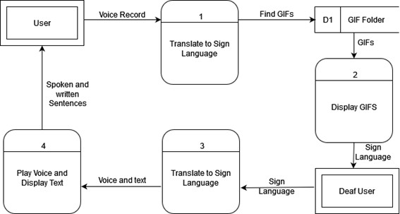
Type header
dataflow diagram
application dataflow diagram

Slide 13
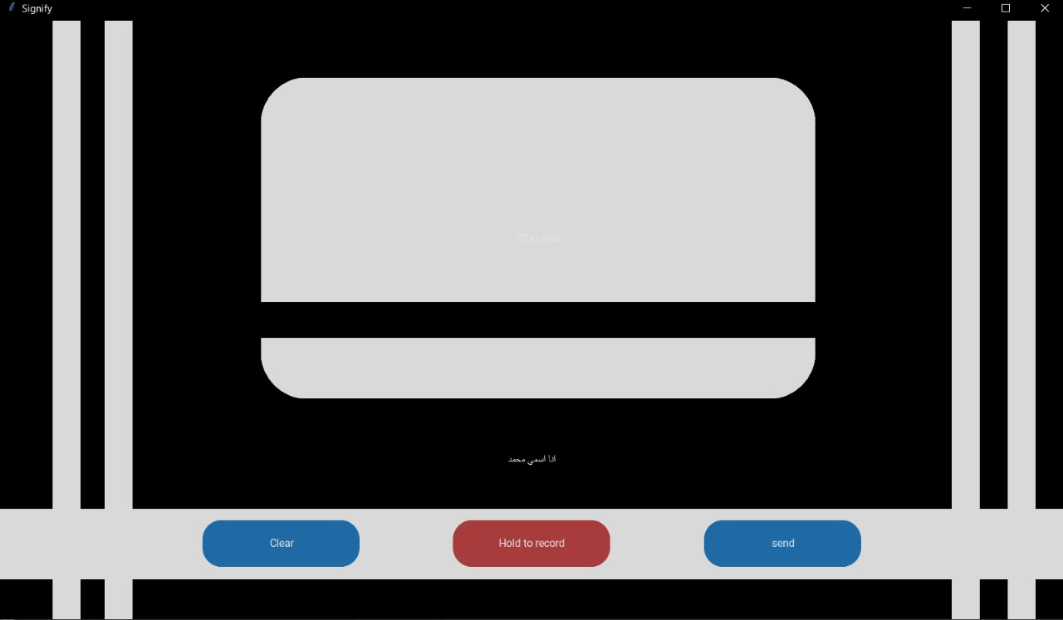
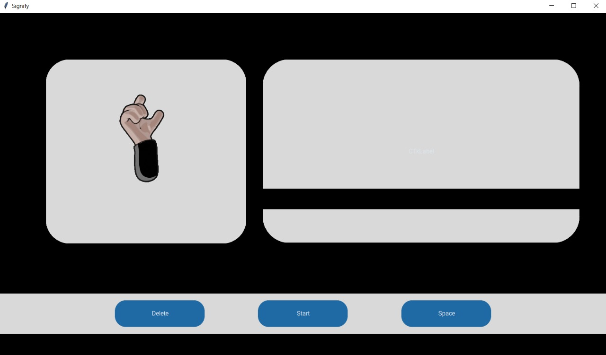
screenshots
Normal user screen
Deaf user screen

Slide 14
our model
Creating data set
We used Mediapipe for detecting the hand and crop it only So, by taking many continuous frames as photos so we could make a lot of data in a short time.
Model structure
We used pre-trained model that called VGG16 that is based on CNN fitted on 10 epochs.
The Result
We have a trained model with 99.6 training accuracy and 99.7 validation accuracy.

Slide 15
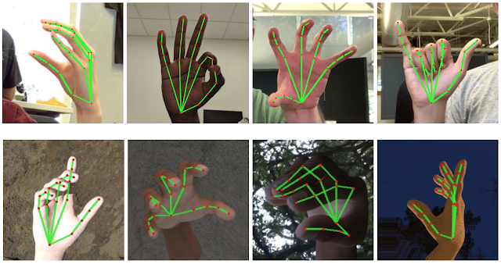
Dataset
We used mediapipe for hand detection:
It employs machine learning (ML) to infer 21 3D landmarks of a hand from just a single frame.
We used it to detect and crop only the hand.
Mediapipe helps us in two challenges:
The limitation of Arabic sign language datasets sources.
Hand detection for the model to start predection.
Dataset description:
We created about 2000 image per character “class” And all dataset is nearly 57200 image.

Slide 16
preprocessing
Steps of preprocessing
Firstly, we crop the detected hand from the image.
Then, we resize it 128*128.
Finally, removing the background as a segmentation.

Slide 17

Model structure
Model structure

Slide 18
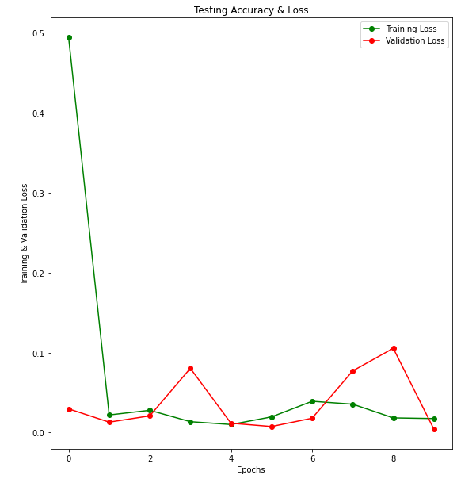
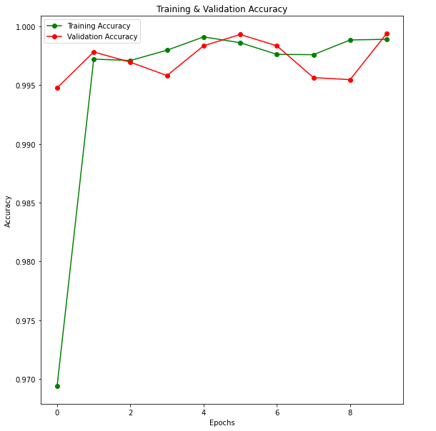
Model Results
 | Accuracy | Loss
Train | 99.6 | 0.0174
Test | 98.2 | 0.0062
Validate | 99.5 | 0.0042
Training and validation loss
Training and validation accuracy

Slide 19
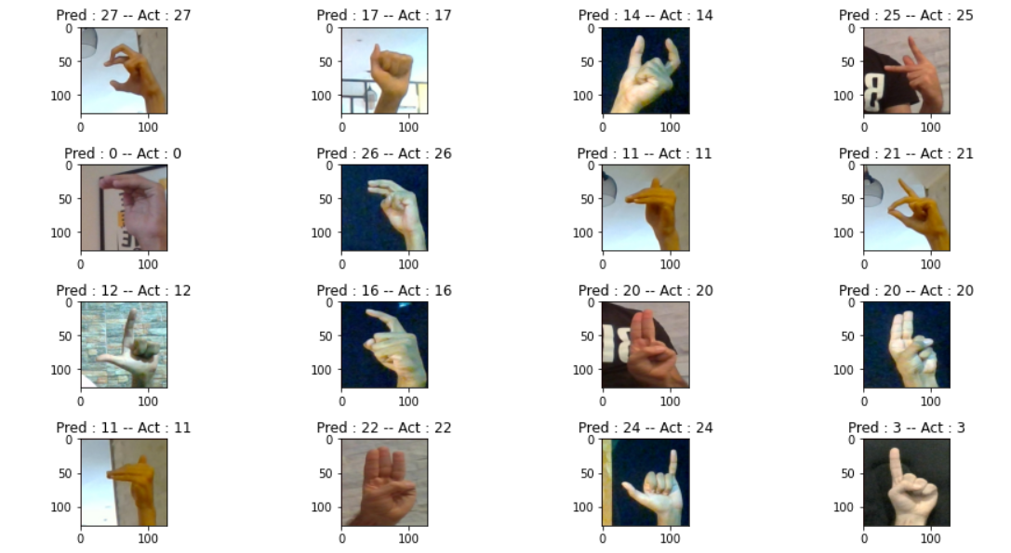
CONT.
Validation test samples

Slide 20
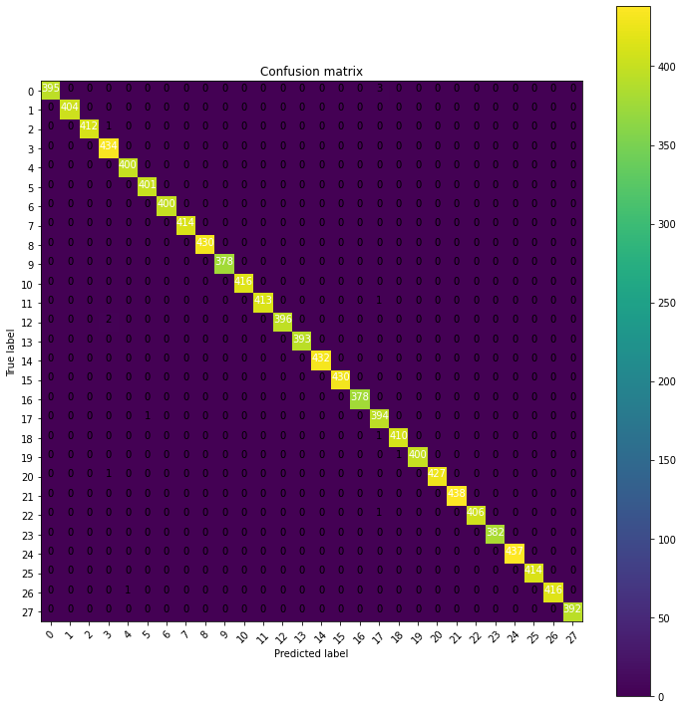
COnt.
Convolutional matrix

Slide 21
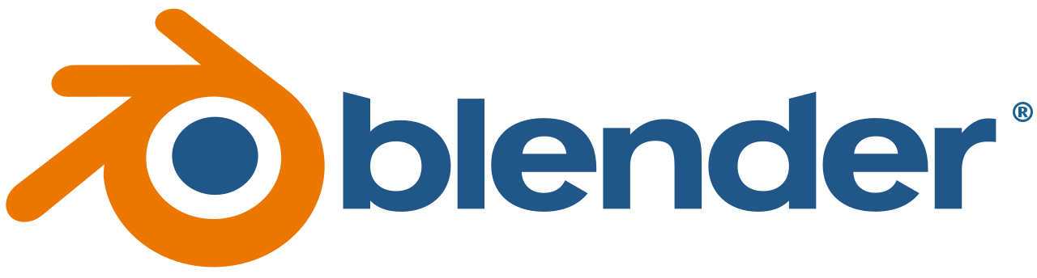
Sign language Animation
Blender
Blender is a free and open-source 3D computer graphics software toolset used for creating 3D-printed models, motion graphics, interactive 3D applications, virtual reality, and, video games. Blender's features include 3D modelling, UV mapping, texturing, digital drawing, raster graphics editing, rigging, and skinning, fluid and smoke simulation, particle simulation, soft body simulation, sculpting, animation, match moving, rendering, motion graphics, video editing, and compositing.

Slide 22
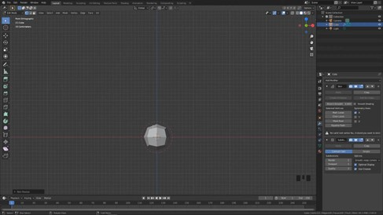
cont.
Blender is a good tool overall for dealing and making 3D models and animating them, Blender was used in this project to make sign-language hand gestures animations, making animations consists of 5 parts:
Creating the model
Rigging
Shading
Animating
Rendering the results

Slide 23
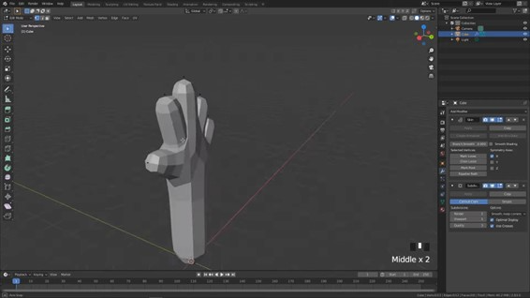
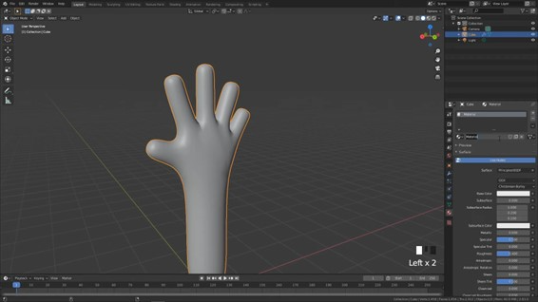
cont.
Creating the model
First, we start from an arbitrary object like a cube or a circle. Then the sculpting part: Sculpting is a feature that allows you to edit clay in Blender as if you were sculpting it with your own hands or using tools to make its surface uneven.
At last we are smoothing model to give it a more natural look.

Slide 24
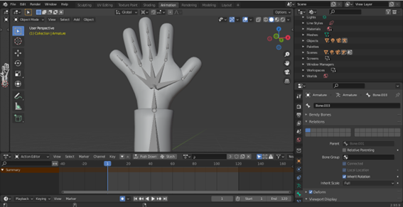
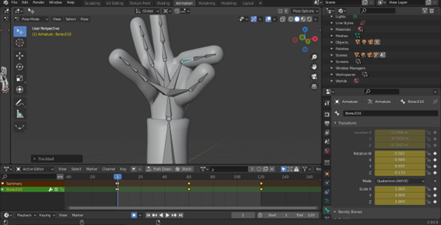
cont.
Rigging
Rigging is one part of the larger animation process.
After a 3D model has been created, a series of bones is constructed representing the skeletal structure. For instance, in a character there may be a group of back bones, a spine, and head bones.
After that comes the animating process, it’s done by moving and rotating the bones.

Slide 25
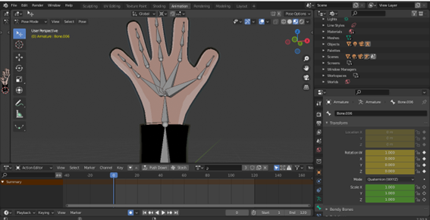
cont.
Shading
shading refers to the process of altering the color of an object/surface/polygon in the 3D scene, based on things like (but not limited to) the surface's angle to lights, its distance from lights, its angle to the camera and material properties.
Shading basically gives 3d objects color and tell 3d objects how to interact with light.

Slide 26
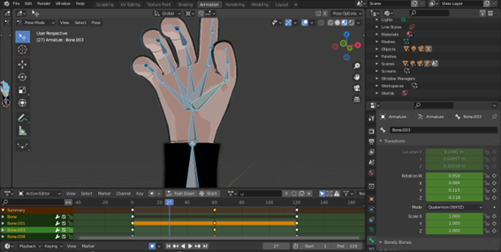
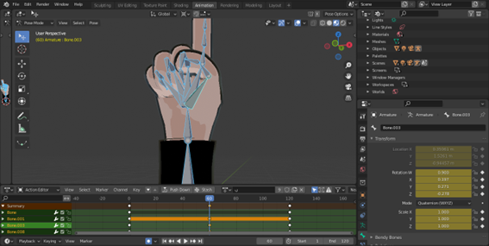
cont.
Animating
Animation is the process of taking a 3D object and getting it to move. The animation of 3D model is done by manipulating bones’ location, rotation, and scale, on a frame-by-frame basis.
Here in this figure, we see the animation process of the letter “ب”

Slide 27
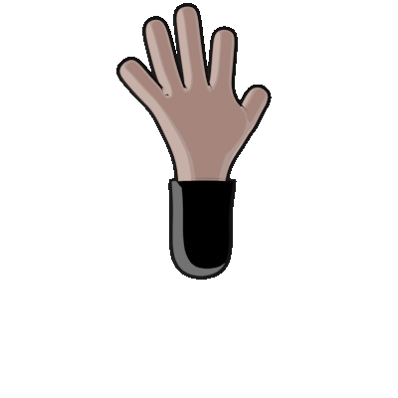
cont.
Rendering
Rendering is converting the 3D model animation sequences into 2D photos, then package those photos together into files and use them in our software.

Slide 28

examples

Slide 29

examples

Slide 30

examples

Slide 31

examples

Slide 32

examples

Slide 33
Conclusion

Slide 34
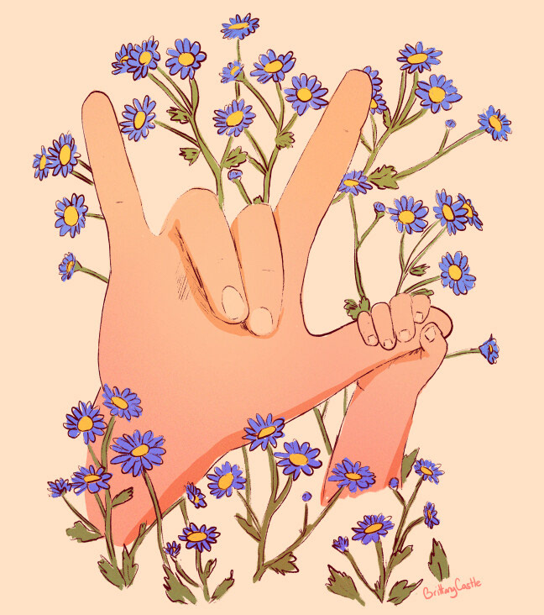
conclusion
The main purpose of Project is providing a feasible way of communication between a Deaf and others by using Desktop Application which takes hand gesture and voice records. The proposed system can be accessed by using webcam or any in-built camera that detects the signs and processes them for recognition and a voice recorder to detect the voice.
From the result of the model, we can conclude that the proposed system can give accurate results under controlled light and intensity. Furthermore, custom gestures can easily be added and more the images taken at different angle and frame will provide more accuracy to the model. Thus, the model can easily be extended on a large scale by increasing the dataset. The model has some limitation such as environmental factors like low light intensity and uncontrolled background which cause decrease in the accuracy of the detection.

Slide 35
improvement
Some improvement that we should do:
In the model, we can increase the dataset. This will increase the accuracy of the model. It’s not easy to collect data with different hand shapes, different Brightness, different camera quality and different backgrounds. That needs a many people to get the dataset.
In the animation, we can reduce the animated time by make an animation depends on the previous and next sign, so we need about 26 * 26 * 26 GIFs to do this. It’s a simulation for making signs in real world.
In front end, we can make more powerful application that has many features.

Slide 36
future work
future work that we need to do:
Mobile application that will make it easy to communicate with all deaf people in the real world , easy to use software everywhere and the won’t fell any differences between us and them they will use the application in they life.
Add learning sign language feature that will make the user to practice sign language every day with interesting exercises.
Make the application fully offline to make it easy to communicate any time anywhere.
Make deaf-blind communication that is really unacceptable in this time.

Slide 37
THANk you

